Slide 1
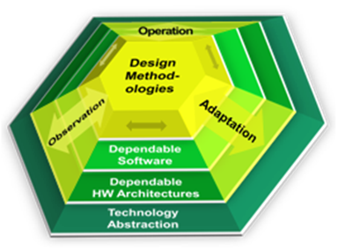
Current Application and Future Perspectives of RAP in CRAU
PIs: Michael Glaß, Jürgen Teich
RAs: Hananeh Aliee, Faramarz Khosravi Hardware/Software Co-Design Friedrich-Alexander-Universität Erlangen-Nürnberg (FAU), Germany faramarz.khosravi@fau.de

Slide 2
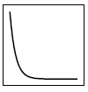
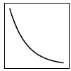
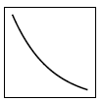
Overview: CRAU Project
CRAU: Compositional System-Level Reliability Analysis in the Presence of Uncertainties
proc. 1
P1
P2
proc. 2
reliability R(t)
system R(t)
0
1
time t
P1
β
P2
β
adapter
α
α
proc. 1 R₁(t)
P1
reliability R(t)
proc.2 R₂(t)
P2
reliability R(t)
β'
time t
β'
time t
P1
P2
proc. 1 T₁(t)
temperature T(t)
proc. 2 T₂(t)
temperature T(t)
time t
time t
M. Glaß et al., “Cross-Level Compositional Reliability Analysis for Embedded Systems”, SAFECOMP 2012.
F. Khosravi | Current Application and Future Perspectives of RAP in CRAU | SPP1500 Miniworkshop
Notes:
CRAU stands for … and its main idea is a cross-layer reliability analysis that decomposes the system architecture and its corresponding reliability model to tame analysis complexity at lower levels, and composes the reliability at system level from the reliability of decomposed parts.
due to analysis complexity, a decomposition into two cores is made
How can we get the reliability of a core?
Runtime information is sent to lower levels via adapters
This information is used by techniques or tools at low level for a concrete analysis
The analysis results are translated again by adapters and sent to higher levels and are used for a system-level analysis
One important effect: temperature-dependent defects
Derive temperature for each core
Use adapter to translate between temperature and reliability
Real-time calculus is used for workload analysis and power traces showing the processor’s activity or activation period are sent down
Temperature simulation is performed using HotSpot tool and traces are put into respective model (“Black’s Equation“)
At top, system is composed back again

Slide 3
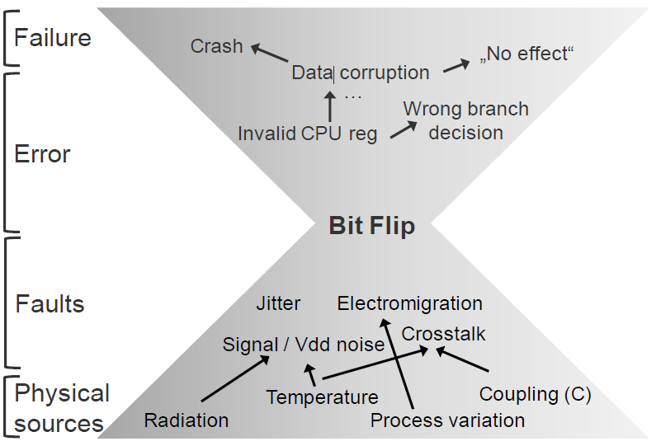
Review: RAP Model
Resilience Articulation Point (RAP) provides a model for probabilistic fault abstraction and error propagation.
All physically induced faults manifest as a transient or permanent, single or multiple bit-flip(s).
A. Herkersdorf et al., “Cross-layer Dependability Modeling and Abstraction in System on Chip”, SELSE, 2013.
F. Khosravi | Current Application and Future Perspectives of RAP in CRAU | SPP1500 Miniworkshop

Slide 4
Application of RAP Model in CRAU
CRN I
Higher level
adapter
Current level
Workload
RAP‘
CRN II
Environment
Analysis / Simulation Technique (Tool)
Structure, Design
CRN II’
CRN II’’
Patterns
RAP
adapter’
adapter’’
Lower level
F. Khosravi | Current Application and Future Perspectives of RAP in CRAU | SPP1500 Miniworkshop
Notes:
According to the RAP model, in each abstraction level, an analysis or simulation tool is used to transform the probabilistic model for bit flip received from the lower level to a model to be used at a higher level.
Such error transformation/propagation is performed while considering the environment which includes the externally imposed workloads from the higher level and the fault exposure patterns obtained from the lower level as well as the design and structure of the system at the current level.
This well matches the idea of CRAU such that at each level of abstraction RAP can be used to transform the low level probabilistic model to upper levels and enable a system level reliability analysis.

Slide 5
Uncertainty Consideration in CRAU
Extending RAP model to represent bit flip probabilities by uncertainty distributions rather than single values
environment
∆e
∆x
system y = f_{e,m}(x)
input
∆y
∆m
manufacturing
F. Khosravi et al., “Uncertainty-aware Reliability Analysis and Optimization”, DATE, 2015.
F. Khosravi | Current Application and Future Perspectives of RAP in CRAU | SPP1500 Miniworkshop
Notes:
The RAP model can be extended by consideration of uncertainty distributions rather than single value for the representation of bit flip probabilities.
Uncertainty that is referred to in the CRAU project contains changes in the environment, manufacturing and process variation as well as fluctuations in the system‘s input.
The changes in the environment can be seen as the variations in temperature or moist as well as changes in the intensity of shocks, radiation, etc.
Fluctuations in the inputs of the system‘s reliability model includes imprecisions in the quantification of component failure probabilities, aging, error propagation and correlation between component failures/aging, or errors in predicting the time interval for which reliability is evaluated, or the stochastic behavior due to runtime workload.
As an example of manufacturing tolerances, variations in oxide dimensions and supply voltage can change the probability of oxide breakdown mechanism, and therefore, significantly affect the device's Time-To-Failure (TTF) distribution which can then be propagated to system-level.

Slide 6
Outline
Overview
Motivation
Uncertainty-Aware Reliability Analysis
Uncertainty-Aware Optimization
Experimental Setup and Results
Future Perspectives of RAP Model
F. Khosravi | Current Application and Future Perspectives of RAP in CRAU | SPP1500 Miniworkshop

Slide 7
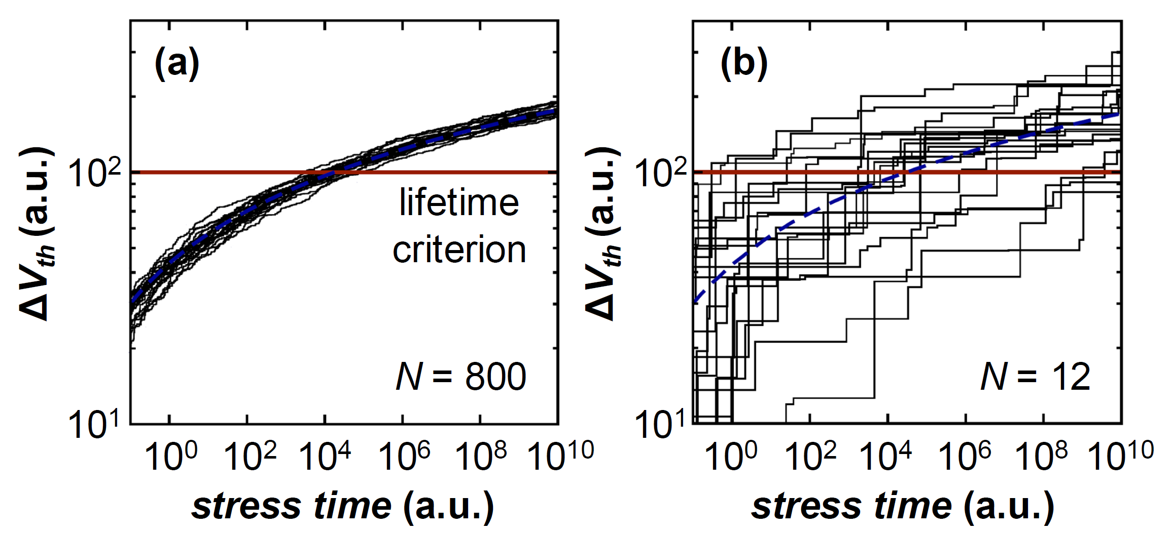
Uncertainty Grows along with Scaling
280nm
35nm
B. Kaczer et al., “Atomistic Approach to Variability of Bias-Temperature Instability in Circuit Simulations”, IRPS, 2011.
F. Khosravi | Current Application and Future Perspectives of RAP in CRAU | SPP1500 Miniworkshop
Notes:
Uncertainty in reliability is getting more significant along with technology scaling and cannot be overlooked anymore.
As an example, Kaczer et al. have observed lifetime variations induced by technology scaling.
Here they measure the changes in threshold voltage during NBTI stress time in multiple experiments and consider a lifetime criterion.
The results are shown here for large technology of 280nm, left, and small size of 35nm with equal defect density that means much fewer defects are injected in the smaller device.
Considering the left plot, the best-case lifetime is one order of magnitude greater than the worst-case that makes it easy to get some notion of the device reliability.
However, in the right plot, the variation is much more significant where at worst-case the device is failed at the very beginning of its operation while at best-case it survived the stress time.
Such significant deviation from the expected lifetime necessitates the consideration of uncertainty in the reliability analysis.
a.u. stands for angstrom unit, however, for threshold voltage the unit is reported in millivolts.

Slide 8
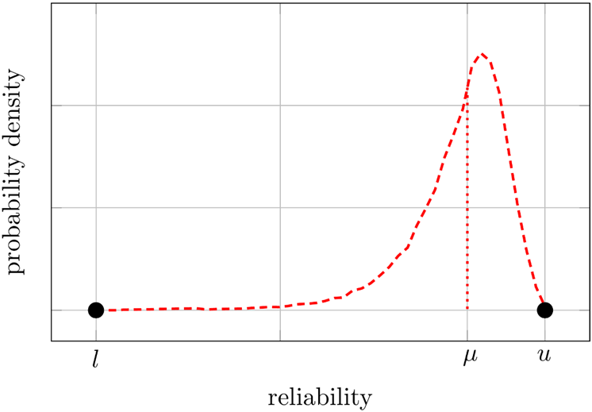
Uncertainty Representation
Existing reliability analysis approaches consider
no uncertainty (lack of safety),
worst-case uncertainty (lack of efficiency), or
average uncertainty (lack of safety).
Uncertainty distribution must be considered to provide safe yet efficient design decisions
F. Khosravi | Current Application and Future Perspectives of RAP in CRAU | SPP1500 Miniworkshop
Notes:
Existing reliability analysis approaches mostly assume the reliability characteristics of the system components to be certainly known, or consider worst-case or average-cased reliability.
I bring an example to show the deficiency of such representations of reliability objectives.
Here, we have two uncertain objectives differently distributed within the same worst and best cases.
First, neglecting uncertainty renders the analysis unrealistic in many cases if the operational conditions vary from the test conditions and cannot be accurately predicted.
It would result in a random point in this interval and ignores the statistical property of the distributions of these objectives.
Second, assuming the worst-case mission profiles is inefficient and inapplicable except for the design of highly safety-critical systems.
Here, it is so pessimistic in case of the second objective, in the red curve, and treats these objectives equally, leading to an inefficient optimization.
Ignoring the small possibility in the lower area of its interval shows a huge potential to design the system less pessimistically with yet a high confidence.
Third, considering the average case neglects the boundary cases which might brings safety issues in case of the second objective where worst-case reliability is much lower than the expectation and might be unacceptable for many applications.
Therefore, the analysis should provide more details about the uncertainty in order to help the designer make safe, yet efficient design decisions.

Slide 9
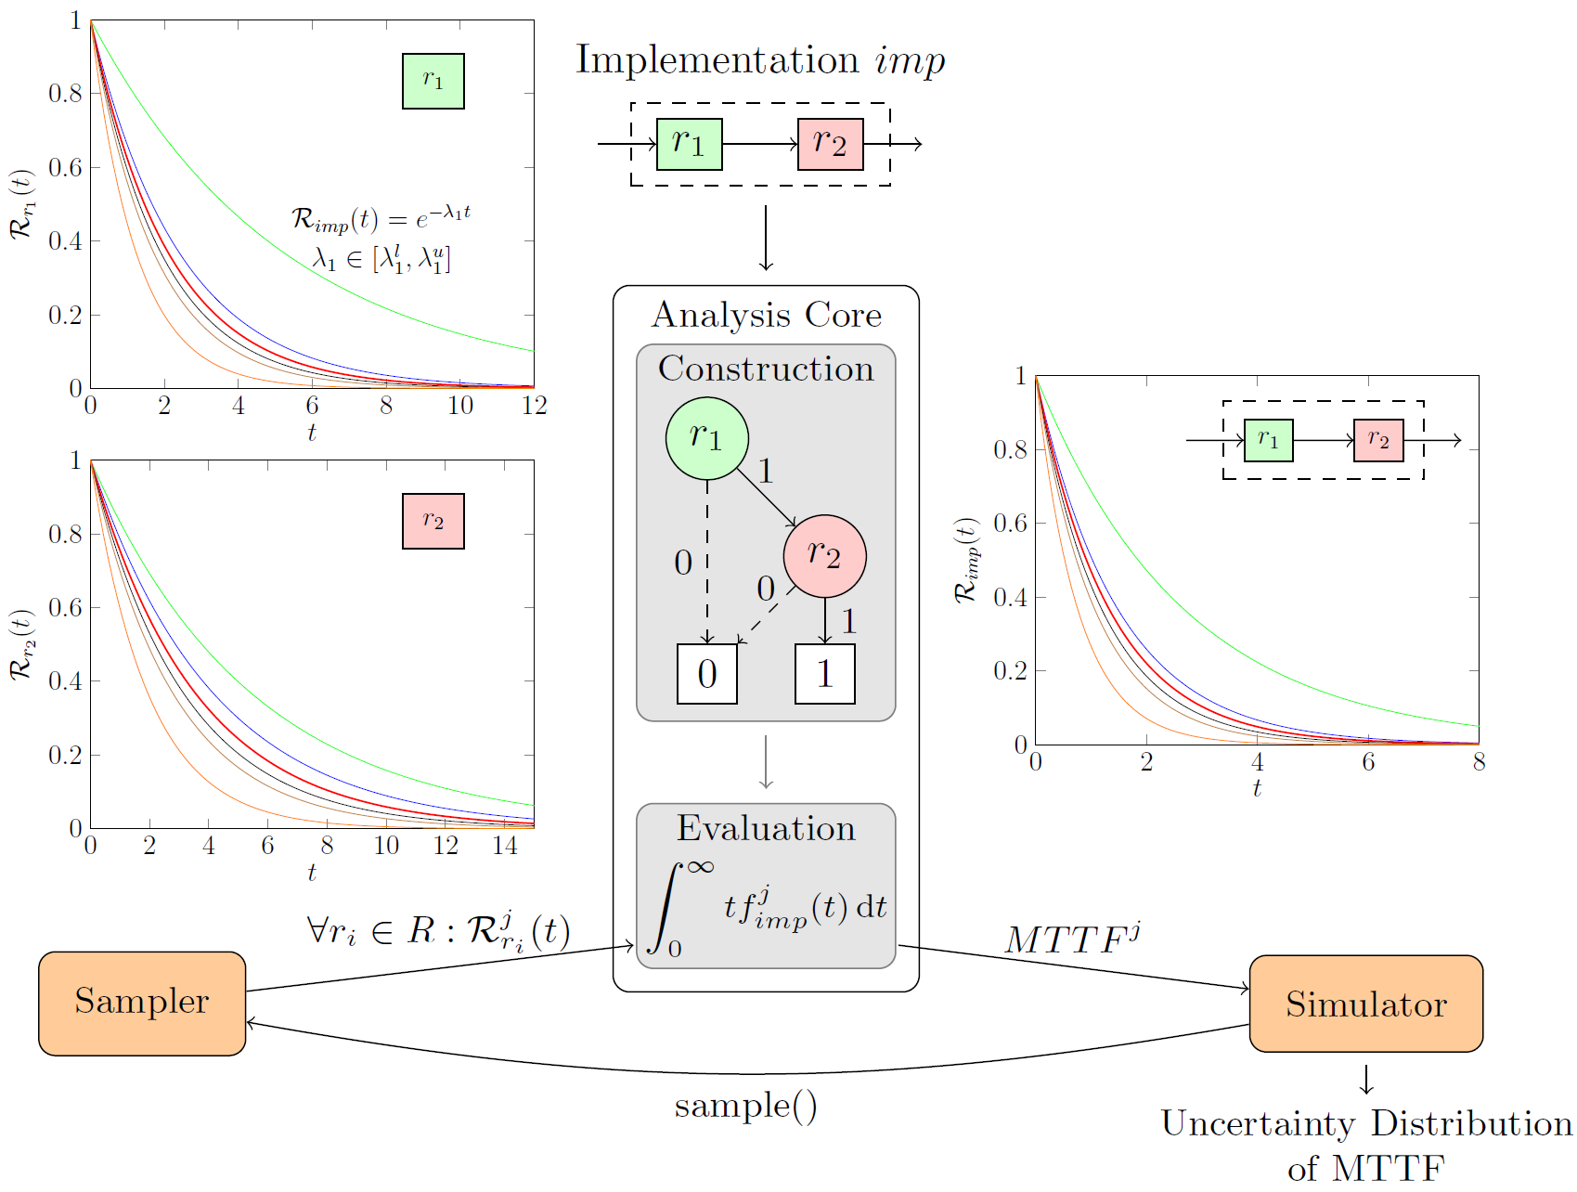
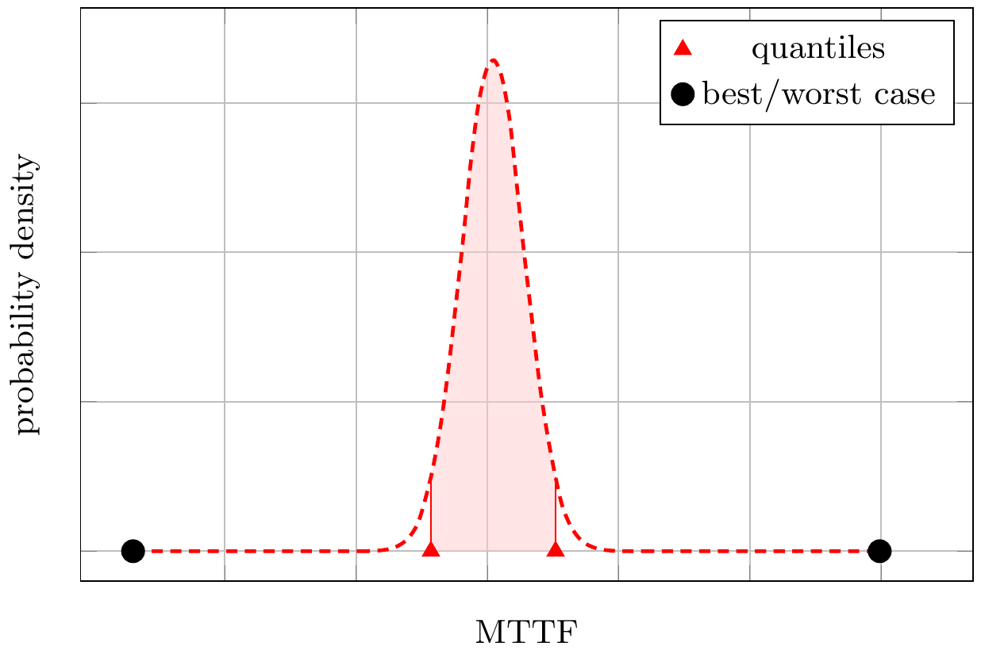
Uncertainty-Aware Reliability Analysis
F. Khosravi | Current Application and Future Perspectives of RAP in CRAU | SPP1500 Miniworkshop
Notes:
To calculate the reliability of an implementation candidate in presence of arbitrarily distributed and correlated uncertainty in its components' reliability, we propose to combine existing reliability analysis techniques with a stochastic process such as Latin Hypercube Sampling.
We first construct a reliability model for the input implementation, for example a BDD where each variable represents the reliability of the corresponding component and sum of paths to the terminal ‘1’ specify the system’s reliability.
Afterwards, we iteratively apply sample reliability functions for all components to the model to obtain sample reliability function of the system that is then used to calculate a sample MTTF value.
A simulator receives the MTTF sample values, calculates various statistical properties including mean, bounds and quantiles for the reliability of the implementation candidate, and determines if further sampling is required.

Slide 10
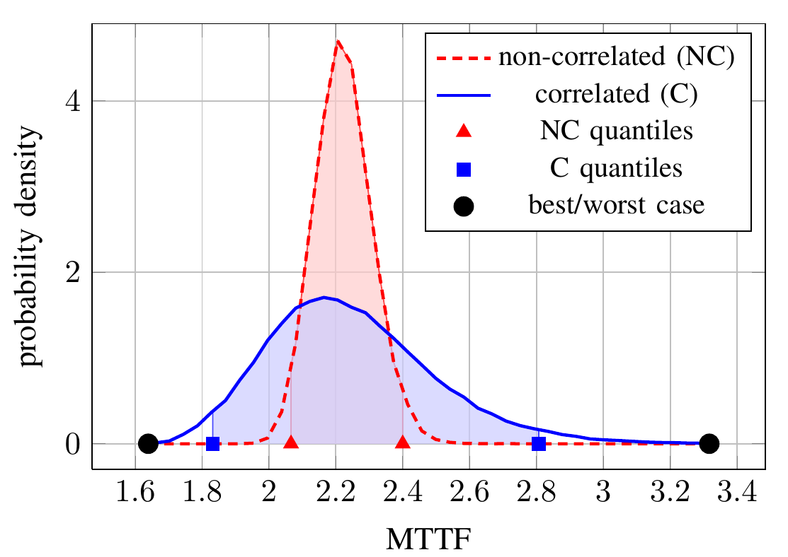
Uncertainty Correlation
Correlation due to common sources of uncertainty
Components in the same package (similar variations in their ambient temperature)
Devices from the same technology (vulnerabilities to similar failure modes)
Products from the same manufacturer (similar manufacturing tolerances and defect densities)
Communicating/cooperating parts (similar changes in their workload)
…
Uncertainty correlation must be considered to provide more accurate uncertainty analysis
F. Khosravi | Current Application and Future Perspectives of RAP in CRAU | SPP1500 Miniworkshop
Notes:
Reliability of different components in the system might be exposed to common uncertainty sources, and thus, correlated.
Common sources of uncertainty in reliability stand for components in the same package which are exposed to similar changes in their ambient temperature, devices from the same technology that are vulnerable to similar failure modes and effects, products from the same manufacturer with similar lifetime distribution, as well as communicating/cooperating parts of the system being under similar workload.
To show the importance of considering uncertainty correlation, this example shows the uncertainty distribution of MTTF calculated for an implementation of an H264 encoder/decoder. Here two cases are considered: the red curve shows the case when the reliability uncertainty of the components are treated independently, whereas the blue curve indicates the case when they are considered correlated. Here, we can see that the resulting distribution and quantiles for the non-correlated uncertainty are far off the theoretical upper and lower bounds, and are significantly different from those for the correlated uncertainty. Therefore, to provide valid and more accurate uncertainty analysis we aim at modeling such correlations among different components in the proposed uncertainty-aware reliability analysis.

Slide 11
Correlation Model
Each component is exposed to either
independent uncertainty
independent sampling for its failure rate
correlated uncertainty
the uncertainty source is common among multiple components forming a correlation group
all components in a correlation group are considered together in the sampling phase
assumption: each component is a member of only one correlation group
r₁
r₂
r₅
r₃
r₄
F. Khosravi | Current Application and Future Perspectives of RAP in CRAU | SPP1500 Miniworkshop
Notes:
Our correlation model considers each component to be exposed to an either independent or correlated uncertainty.
In the former case, samples from its uncertain parameter, here its failure rate, are generated independent of those for the other components.
On the other hand, being exposed to the same uncertainty source, multiple components can form a correlation group and be considered together in the sampling process.

Slide 12
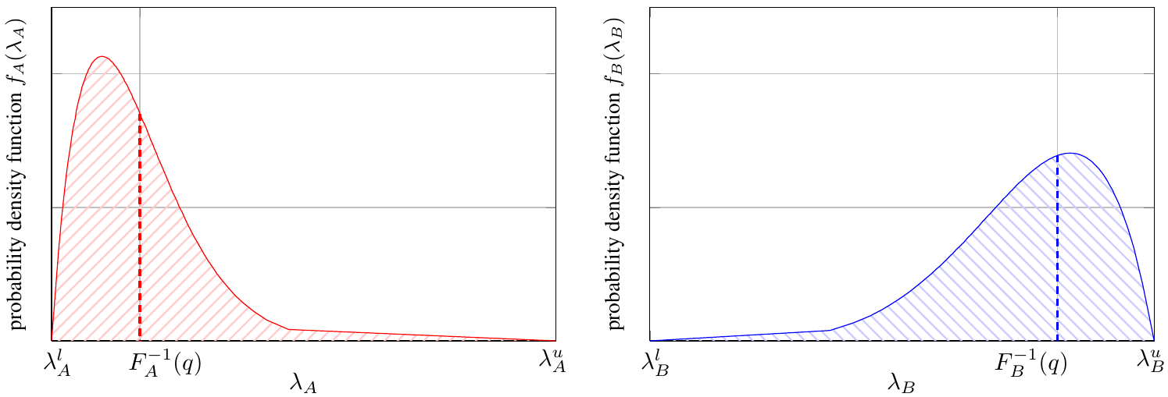
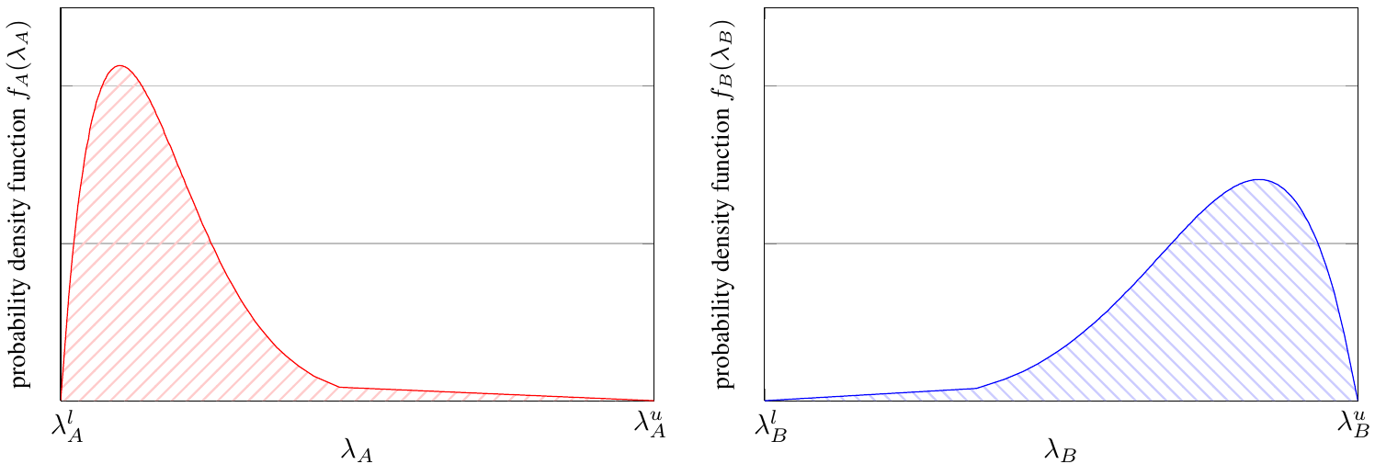
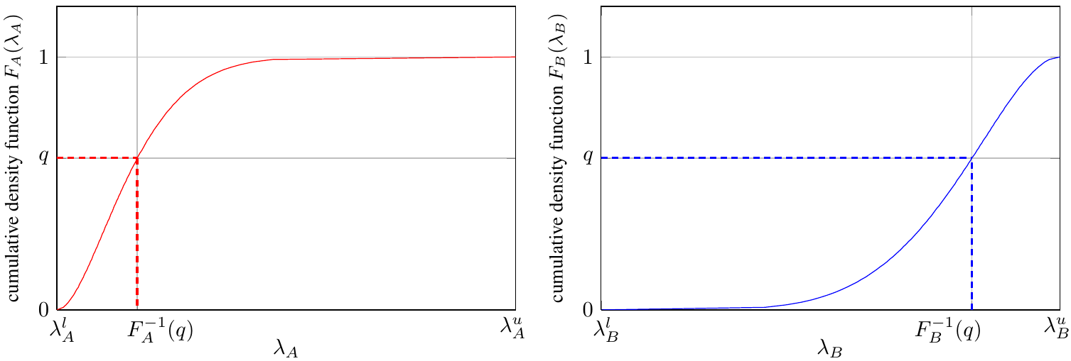
Quantile-based Correlation Model
Taking a sample $q$ from a uniform distribution between 0 and 1 for each group, representing the common quantile
Returning the corresponding value $F^{−1}\left(q\right)$ from the distribution of each component using the inverse cumulative distribution function
F. Khosravi | Current Application and Future Perspectives of RAP in CRAU | SPP1500 Miniworkshop
Notes:
To sample from arbitrary distributions while considering correlation, we propose a method based on considering common quantile representation of each component in a correlation group.
In each correlation group, instead of sampling for the components independently, we take a sample from a uniform distribution between 0 and 1 for each group, representing its common quantile.
Then, for each component in a group we return the corresponding point where its distributions reach this quantile value. Using inverse cumulative function $F^{−1}\left(q\right)$.
For example, assume two components A , left, and B, right, are in a correlation group. Above we have the cumulative density function and we take a sample q_i between 0 and 1 to represent the common quantile probability of the group. The corresponding point can be then found .
Although the quantiles are the same, since distributions are heterogeneous, different points can be found for different components.
Due to arbitrary uncertainty distribution, the correlation coefficients would differ among components in the same group, however, a correlation coefficient of 1 always holds in the quantile space since the all components are sampled through the same quantile probability.

Slide 13
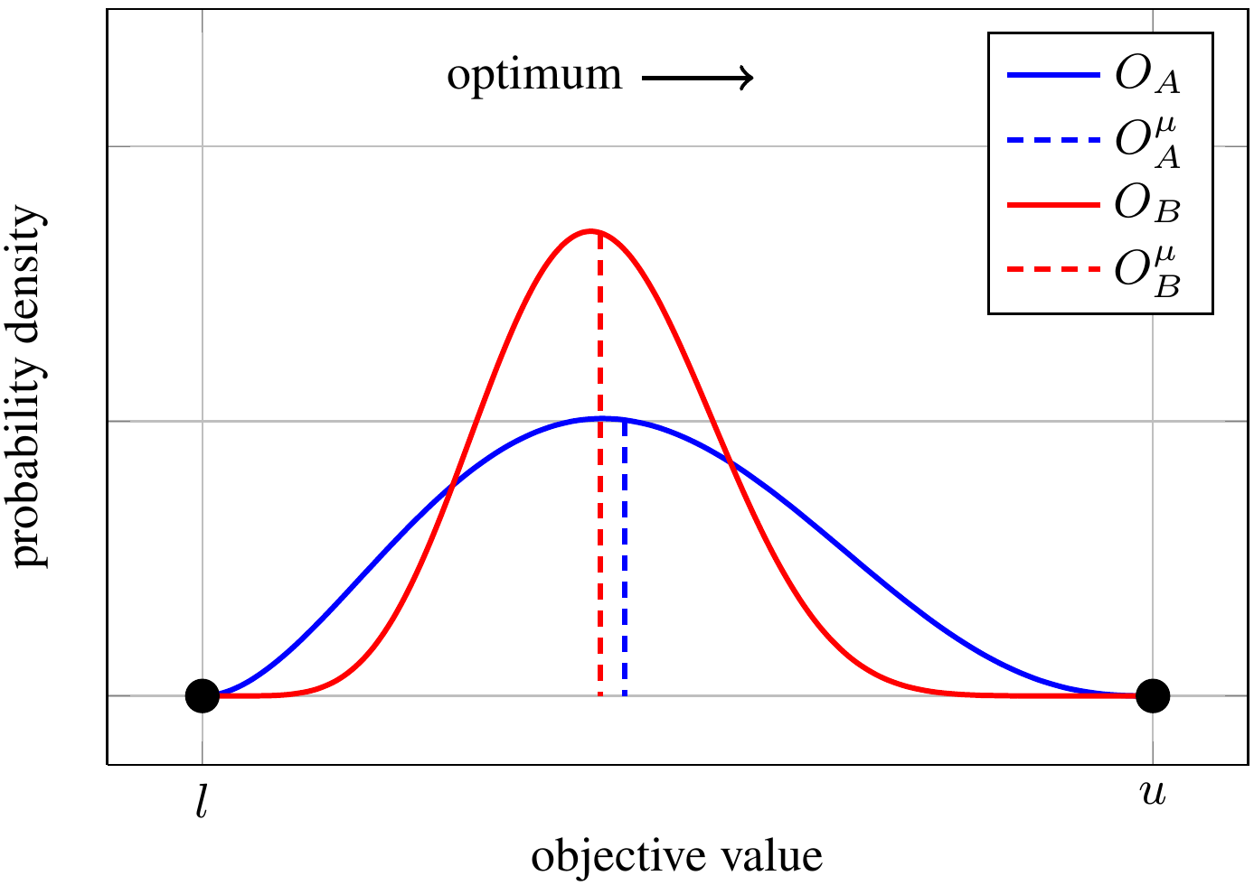
Considering Uncertainty in Optimization
How to compare multiple solutions (distributions) in terms of superiority?
Existing optimization techniques are either
uncertainty-unaware
or require design objectives to be
a single real value (statistical property such as expected value, worst-case, etc.)
an instance of known distributions such as Uniform and Normal
F. Khosravi | Current Application and Future Perspectives of RAP in CRAU | SPP1500 Miniworkshop
Notes:
Existing uncertainty-aware optimization techniques typically assume the design objective to be certain.
The uncertainty-aware approaches also require uncertain design objectives to be a single value representing a statistical property of its uncertainty or to follow known, homogenous distributions.
Nonetheless, the uncertainty in design objectives may follow any arbitrary distribution according the measured field data.
Moreover, considering only one statistical property might not be enough to achieve efficient, safe comparison as I previously said.
Therefore, an uncertainty-aware optimization technique should take advantage of different statistical details of the uncertainty distribution, and dynamically adopt the comparison criterion to the proper property to provide accurate, yet fast comparison.
Assume we intend to compare two uncertain objectives, considering the boundary cases cannot differentiate between these distributions and leads to keeping both implementations incomparable which would increase the degree of indifference among different objectives and overflow the solution archive.
Nonetheless, the designer can exploit the statistical properties like mean, variance as well as quantile intervals according to the problem specific requirements to decide either to discard one implementation or to keep both.

Slide 14
Uncertainty-Aware Optimization
Multi-objective meta-heuristic optimization is
applicable to a wide range of problems
capable of fast multi-objective convergence
An uncertain objective is represented by
a set of samples
a set of statistical properties including mean, variance, quantiles, etc.
F. Khosravi | Current Application and Future Perspectives of RAP in CRAU | SPP1500 Miniworkshop
Notes:
The optimization framework is built upon multi-objective meta-heuristic optimization which is applicable to a wide range of problems and is capable of fast multi-objective convergence. Here, each uncertain objective is considered as a distribution which is represented by either a set of samples or a set of statistical properties such as mean and variance. The latter representation is preferred due to its lower overhead.

Slide 15
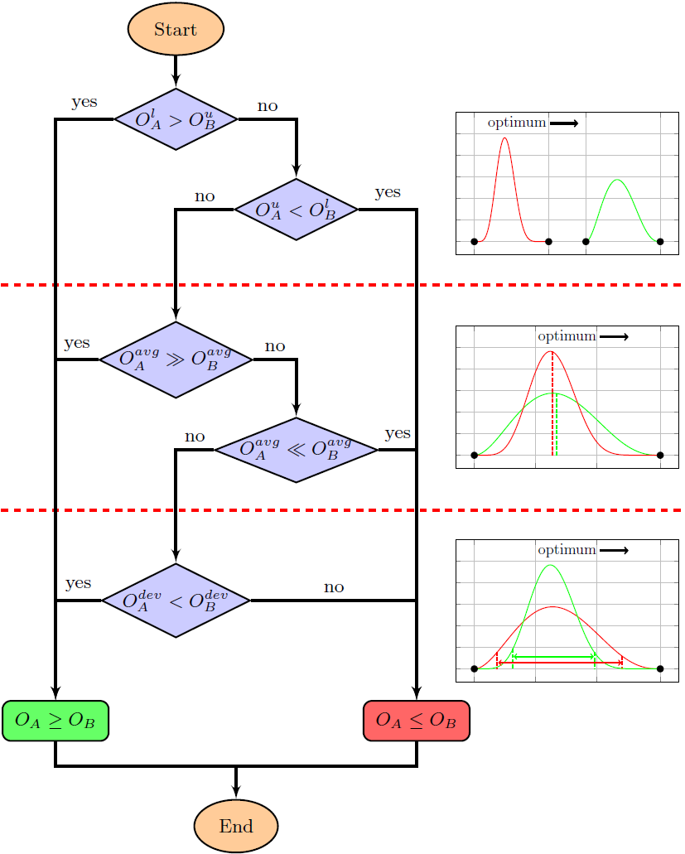
Comparison of Uncertain Objectives
F. Khosravi | Current Application and Future Perspectives of RAP in CRAU | SPP1500 Miniworkshop
Notes:
To enable the optimization of uncertain objectives, we proposed an adaptive dominance criterion based on a three-stage compare operator to distinguish between individual objectives being compared.
In the first stage the bounds are compared, if the worst-case of the objective A excels the best case of the objective B, A is always better than B and then preferred.
Since reliability optimization is a maximization problem, being better is denoted by greater sign.
If no preference can be made according to the bounds, we compare the average cases such as mean or median so that the one with considerably better average case is preferred. A threshold value ε is introduced in order to determine how much an objective should be greater than the other in average case to be chosen.
Its value can be determined by the designer according to the objective criticality and problem specific requirements
the interval between average metric (mean, etc.) should be significant in proportion to the whole interval covered by two objectives
If the objectives are not comparable using the average metric the one with less deviation (variance, quantile intervals, etc.) will be preferred.

Slide 16
Experimental Setup
System-level reliability analysis for given 1000 samples to obtain a maximum error of 0.001 with 95% confidence
Design Space Exploration using Opt4J tool*
Non-dominated Sorting Genetic Algorithm II**
Size of population (offspring per generation) = 25
Number of generations = 100
* M. Lukasiewycz et al., “Opt4J: A Modular Framework for Meta-heuristic Optimization”, GECCO, 2011.
** K. Deb et al., “A Fast Elitist Non-dominated Sorting Genetic Algorithm for Multi-objective Optimization: NSGA-II”, PPSN, 2000.
F. Khosravi | Current Application and Future Perspectives of RAP in CRAU | SPP1500 Miniworkshop
Notes:
The Monte Carlo simulation needs 1000 evaluations to achieve a maximum error of 0.001 with 95% confidence for the expected value in our reliability analysis.
However, the number of samples can be adaptively changed regarding the required confidence and the time overhead.
The proposed uncertainty-aware reliability analysis and optimization are integrated in a DSE which uses the OPT4J optimization framework.
We use the well-known Non-dominated Sorting Genetic Algorithm II (NSGA-II) with a population size of 25 during 100 generations.
To evaluate the proposed analysis and optimization we use three test problems including a real-world and two synthetic with different complexity introduced by number of resources, tasks, mappings, and possible hardening variants.

Slide 17
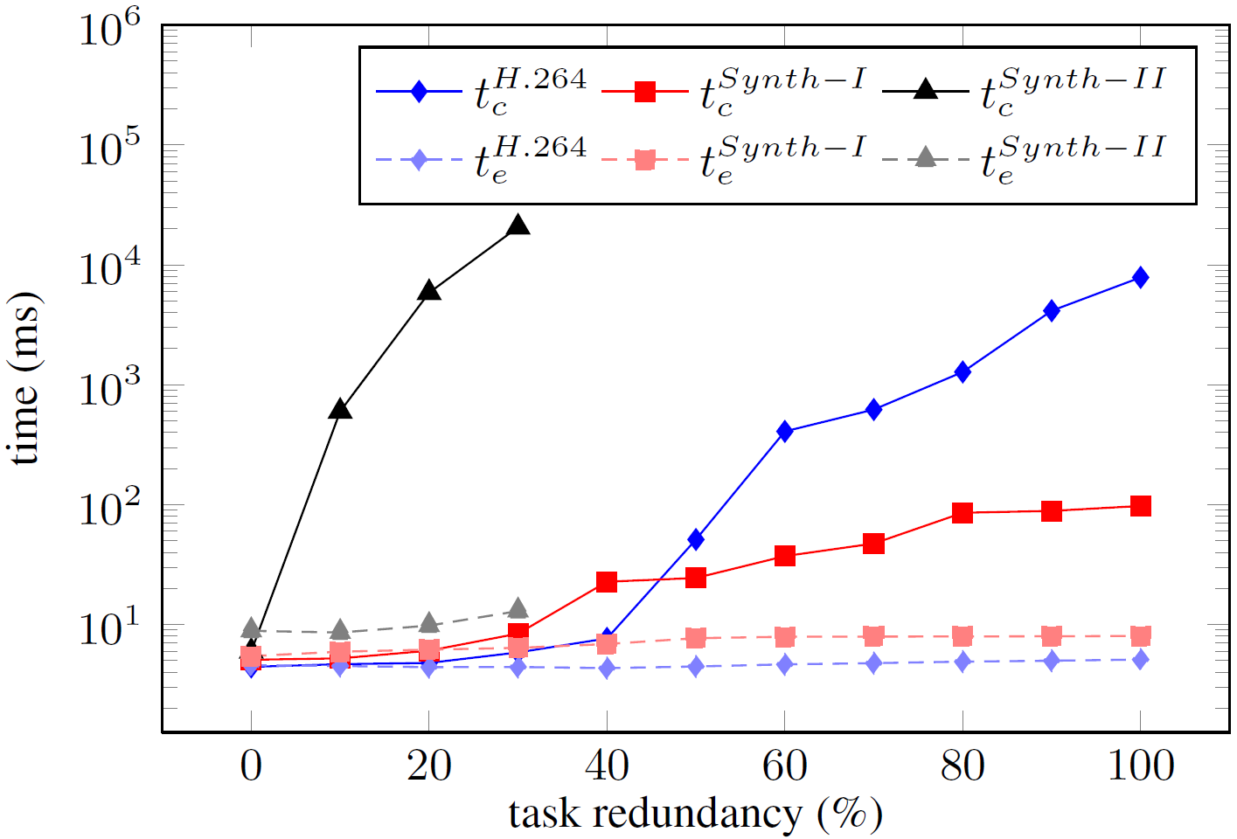
Experimental Result: Analysis Time Overhead
Construction time $t_{c}$: once per analysis
Evaluation time${ t}_{e}$: once per sample
$$t_{a}(1)=t_{c}+t_{e}$$
$$t_{a}(n)=t_{c}+n.t_{e}$$
F. Khosravi | Current Application and Future Perspectives of RAP in CRAU | SPP1500 Miniworkshop
Notes:
The major execution time overhead in our uncertainty-aware design is imposed by the Monte Carlo simulation which re-evaluates the reliability model several times.
The analysis time ignoring the Monte Carlo simulation equals the sum of the time required for construction and the time required for the evaluation of the reliability model. The Monte Carlo simulation only replicates the evaluation time by a factor of the number of samples.
Since the evaluation can be performed in a polynomial time while model construction is of NP-hard complexity, the overall time overhead is acceptable.
Here we see the result of evaluating the analysis time overhead for the used test problems for different redundancy level.
The 100% redundancy means that all the tasks are duplicated for reliability improvement.
Light curves show the evaluation time while the dark curves indicate the time required for the model construction.
Note that the time axis is in log scale.
In case of the first and third test problem, the blue and black curves, 1000 evaluations would impose an overhead of less than 65% at the highest redundancy level, while the second test case increases the analysis time with a factor of 82. However, the total analysis time for this case and for lower redundancy levels is still acceptable for a DSE. (considering the most complex test problem and the highest the analysis would take around 5.7 minutes per implementation and 9.7 days for the whole optimization. The proposed method is able to adaptively set epsilon and the number of samples with respect to the overhead and required confidence)

Slide 18
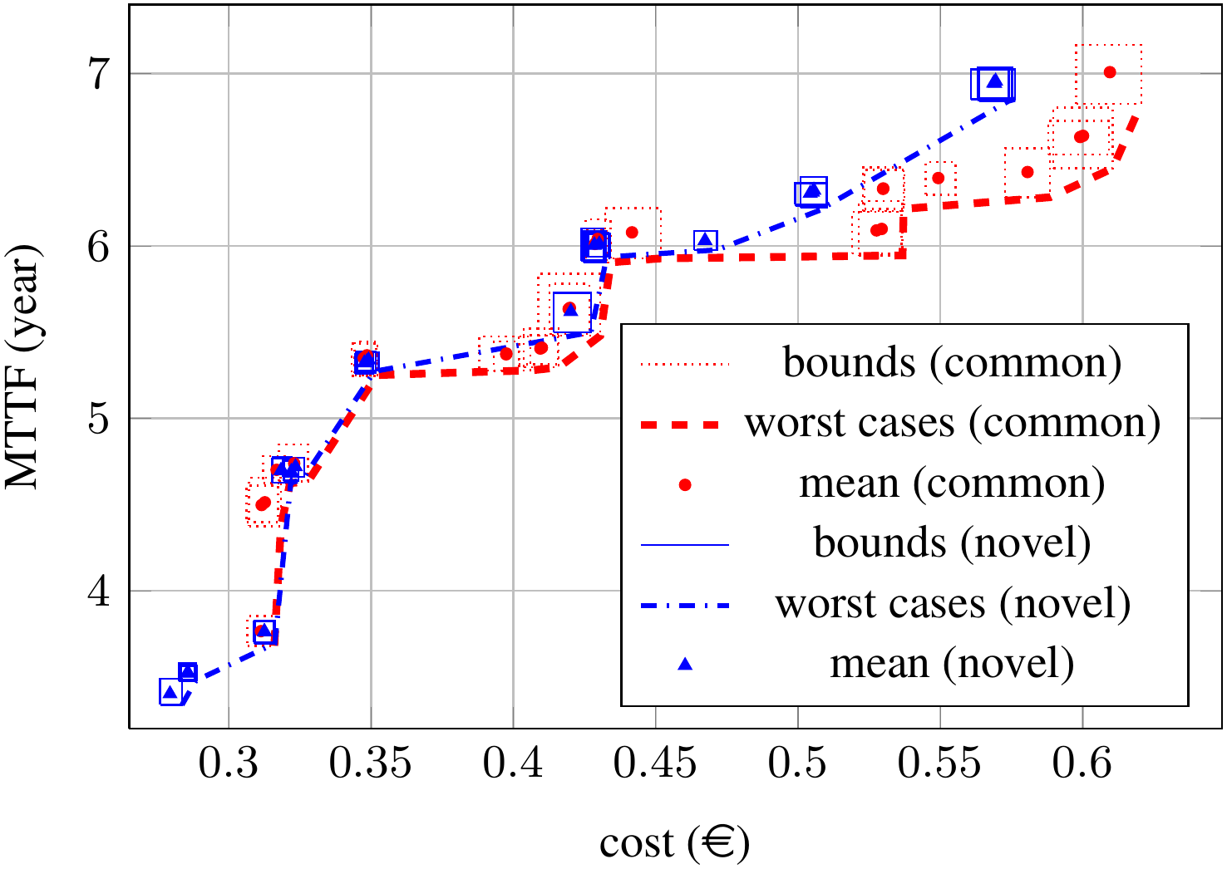
Experimental Result: Multi-objective Opt.
F. Khosravi | Current Application and Future Perspectives of RAP in CRAU | SPP1500 Miniworkshop
Notes:
Here we can see the optimization results for uncertain MTTF and cost achieved by our novel compare operator, shown in blue, and a common approach which compares only the average cases, shown in red.
The goal is to reach top-left corner through maximizing MTTF and minimizing cost and also to minimize the confidence interval for these objective that means that smaller boxes is preferred.
As can be seen, we have reached as good and even better optimization quality besides our success in finding implementations with less uncertainty.

Slide 19
Future Perspectives
Enhancing the Correlation Model
Each component can be member of more than one correlation group
Components in a group can be correlated to the common uncertainty source to different degrees
Cross-layer probabilistic common cause failure analysis
Identification and quantification of common cause events and their impacts on system’s components at low level
Reliability analysis considering probabilistic common cause failure among components at system level
F. Khosravi | Current Application and Future Perspectives of RAP in CRAU | SPP1500 Miniworkshop

Slide 20
References
[1] M. Glaß et al., “Cross-Level Compositional Reliability Analysis for Embedded Systems”, SAFECOMP 2012.
[2] A. Herkersdorf et al., “Cross-layer Dependability Modeling and Abstraction in System on Chip”, SELSE, 2013.
[3] F. Khosravi et al., “Uncertainty-aware Reliability Analysis and Optimization”, DATE, 2015.
[4] B. Kaczer et al., “Atomistic Approach to Variability of Bias-Temperature Instability in Circuit Simulations”, IRPS, 2011.
[5] L. Thiele et al., “Real-time Calculus for Scheduling Hard Real-time Systems”, ISCAS, 2000.
[6] W. Huang et al., “Hotspot: A Compact Thermal Modeling Methodology for Early-stage VLSI Design”, TVLSI, 2006.
[7] M. Lukasiewycz et al., “Opt4J: A Modular Framework for Meta-heuristic Optimization”, GECCO, 2011.
[8] K. Deb et al., “A Fast Elitist Non-dominated Sorting Genetic Algorithm for Multi-objective Optimization: NSGA-II”, PPSN, 2000.
F. Khosravi | Current Application and Future Perspectives of RAP in CRAU | SPP1500 Miniworkshop

Slide 21
Thanks for your attention! Questions?
Current Application and Future Perspectives of RAP in CRAU
PIs: Michael Glaß, Jürgen Teich
RAs: Hananeh Aliee, Faramarz Khosravi Hardware/Software Co-Design Friedrich-Alexander-Universität Erlangen-Nürnberg (FAU), Germany faramarz.khosravi@fau.de

